Slide 1

August 2026
Growth Portfolio
Is this right for you?
This portfolio would potentially be suitable for someone looking for the potential of long-term returns and provide medium-high growth on top whilst being happy with moderate-high short-to-medium-term volatility in the returns. The investor would need to accept the potential for capital loss.
Investment Approach
The portfolio utilises a core-satellite approach investing 80-90% of the funds into low-cost passive funds with the remaining 10-20% in active investments for real estate and alternative positions.
Our approach to managing the passive element of the portfolio is to make asset allocation decisions dependent on the global economic outlook. Our investment mandate provides the flexibility to go 10% over/under the Morningstar PIMFA benchmark asset allocation weightings we measure our performance against.
The Morningstar PIMFA benchmarks series consists of five composite indices designed to represent the weightings and show returns of selected multi-asset-class strategies, determined by the PIMFA Private Investor Indices Committee, the Morningstar PIMFA Growth benchmark aims to represent an investment strategy of a client seeking an approach focused on capital growth in their portfolio.
Asset Allocation
Portfolio rating
Lower risk
Higher risk
Typically lower rewards
Typically higher rewards
The risk rating of a portfolio is determined on the asset types it invests in.
Equities are typically higher risk yet typically provide a higher return. While bonds are typically lower risk though providing a lower return over the long term.
UK Equities | 17.5%
International Equities | 60.0%
Government bonds | 2.5%
Corporate bonds | 7.5%
Inflation-linked bonds | 0.0%
Cash | 2.5%
Real Estate | 2.5%
Alternative | 7.5%
Please note: that asset allocations and returns provided in this document are valid as of
31st August 2026.
This fact sheet is only a guide to the portfolio described and the constituents and their weightings are subject to change at any time. Issued by Daintree Wealth Management which is a limited company registered in England and Wales under registered number 10862963 and is authorised and regulated by the Financial Conduct Authority. Registered office: Unit 3, Building 2 The Colony Wilmslow, Altrincham Road, Wilmslow, Cheshire, England, SK9 4LY. Trading Address: 1 Balloon Street, Manchester, M4 4BE.

Slide 2
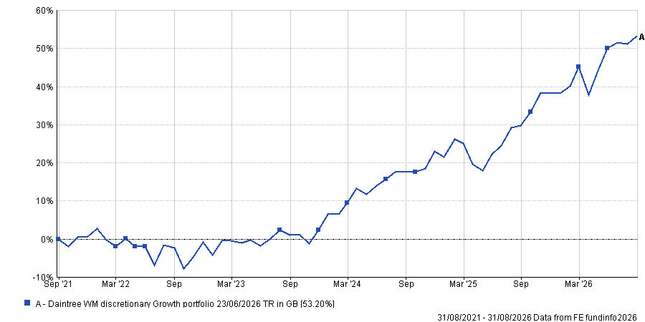
August 2026
Growth Portfolio
5Yr cumulative performance
Discrete performance
Time period | Portfolio Total returns
31/08/2025 – 31/08/2026 | +18.00%
31/08/2024 – 31/08/2025 | +10.34%
31/08/2023 – 31/08/2024 | +16.46%
31/08/2022 – 31/08/2023 | +3.42%
31/08/2021 – 31/08/2022 | -2.30%
The returns in the above graph and table are simulated historical returns based on the asset allocation and weighting of the Daintree Wealth Management Core Growth portfolio against the ARC Sterling Equity Risk PCI Benchmark from 31st August 2021 to 31st August 2026.
The above table provides discrete yearly performance in one-year blocks from the 31st August 2021.
As they are based on benchmark returns, they are therefore exclusive of charges.
This data is valid as of the 31st August 2026.
Risk warnings: Past performance is not a guide to future performance. The value of investments any income is not guaranteed and can go down as well as up and may be affected by exchange rate fluctuations. This means that an investor may not get back the amount invested.

Slide 3
January 2026
Balanced Portfolio
Portfolio holdings
August 2026
Growth Portfolio
Asset Class | Security name | Weight (%)
International equities | Vanguard developed world (ex-UK) ETF | 24.25%
International equities | SPDR® MSCI ACWI IMI UCITS ETF | 24.25%
International equities | iShares S&P 500 ETF | 4.50%
International equities | Vanguard LifeStrategy® 100% Equity Fund | 7.00%
UK equities | iShares MSCI UK UCITS ETF | 17.50%
Government bonds | Royal London Short Duration Gilts Fund | 0.62%
Government bonds | Vanguard UK Gilt UCITS ETF Accumulating | 1.88%
Corporate bonds | iShares Corporate Bond Index Fund (UK) | 3.75%
Corporate bonds | M&G Short Dated Corporate Bond Fund | 3.75%
Property | iShares MSCI Target UK Real Estate ETF | 2.50%
Alternatives | Dimensional Global Short Dated Bond | 3.75%
Alternatives | iShares MSCI World Multifactor ETF | 3.75%
Cash | Cash | 2.50%
Total |  | 100.00%
The above table represents the target weight of our growth portfolio as of 31st August 2026, the actual weight may vary between portfolios based on the actual performance of the holdings.
Risk Warnings:

Slide 4
August 2026
Growth Portfolio
Costs and charges
In alignment with our values, we believe in being transparent and honest.
Fee type | Percentage amount (per annum)
Investment Management fee* | 0.42%
Underlying funds fee** | 0.19%
*These fees are in addition to our financial planning fee of 0.75%
** Subject to variation depending on investment performance.
These figures are valid as of the 31st August 2026.

